Slide 1
Name: Prajapati Urva Pareshbhai
Student ID: 12190172
Week 7 practice presentation

Slide 2

Internet of Things Security and Privacy Challenges

Slide 3

What is Security !!!
The quality or state of being secure – to be free from danger.
A successful organization should have multiple layers of security like
Personal security
Physical security
Operations security
Communications security
Network security
Information security

Slide 4
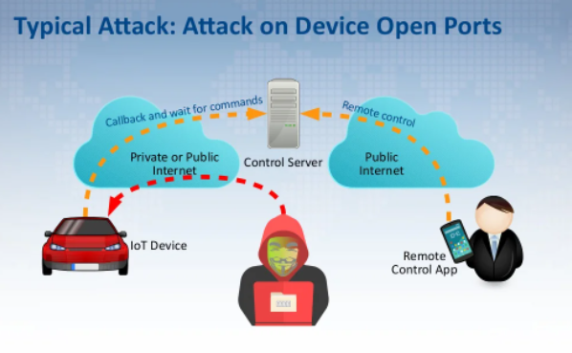
What is the Information security
The protection of information and its critical elements, including systems and hardware that use, store, and transmit that information.
Tools : policy, training, awareness, education and keep to update with the latest technology
In ICT security is concerned with malicious humans that actively search for and exploit weaknesses in a system.

Slide 5
Privacy challenges
There are three major privacy issues we facing when surfing the web.
(1) Spying and snooping
So, when you are online you are spying by several trackers or hackers with various purposes, trackers keep a record of your searched history and track all your online activities. So, this provide them clear picture of who you are and what your interests. Most of time this tracking is for advertisement purpose only and it allows advertisers to show ads according to your interests.

Slide 6
(2) Information mishandling
There millions sites on the internet that ask about our personal information to get access for their services.
But the most of time this information is not encrypted and can be accessed by anyone. In this modern world of E-banking it is very risky to access this online sites. By sharing your bank details and crucial files on the internet you are paying ways for hackers and making yourself vulnerable to criminals.

Slide 7
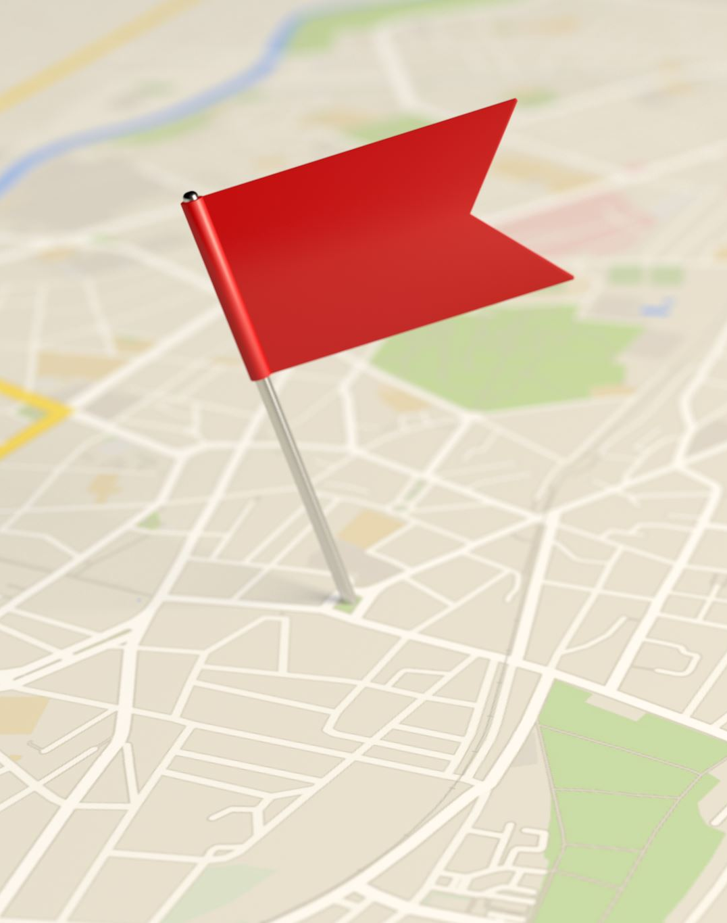
(3) Location tracking
Most of the internet users proudly upload their social media posts highlighting their current location along with tagging friends and family members. This data is stored there forever without knowing you. Along with social media other apps like google maps ask for our location and by turning on you provide them your all location, where exactly you are and what is your next move. And this information they are use for advertisement and other vulnerable purpose.

Slide 8
KEY AND LOCK Ways to protect against this privacy threats
Use a VPN:
There are various ways to protecting our online privacy, but the most successful way is VPN which we called as Virtual private network.
Which provide us an anonymous IP address and hide our actual identity across the internet
Some VPN work in small scale, is only accessible to only few countries, and other paid ones which we can use internationally.
Conduct Safe Browsing:
Block ads on browser and pay extra time to read privacy

Slide 9
Use Anti-Virus:
Use trusted Anti-Virus will keep your device free to bugs and any type of malware such a trojans, viruses and spyware. Using an anti-virus is essential to get real time updates
Changing in setting on social media
Big companies like goggle and Facebook provide option to strong our security and hide our information on web like two-time authentication or private account.

